Slide 1
GEECCO Log Journal
Tutorial – How to use the GEECCO Log Journal (Excel Template)
February 23, 2021
Grant agreement No 741128

Slide 2
Content
GEECCO Log Journal – Aim and Target Groups (slide 3)
GEECCO Log Journal Tutorial – Learning Objectives (slide 4)
Preconditions for optimal use of the GEECCO Log Journal (slides: 5-6)
Step-by-Step Guide (slides 7-13)
Background Information: GEECCO Log Journal Tutorial Development (slide 15)

Slide 3
GEECCO Log Journal – Aim and Target Groups
Aim
To serve as resource for monitoring the implementation of gender equality measures in research funding organizations (RFOs)
Target Groups
Gender Equality Officers in RFOs
Gender Change Agents in RFOs

Slide 4
GEECCO Log Journal Tutorial – Learning Objectives
Acquiring knowledge on preconditions for optimal use of the GEECCO Log Journal
Acquiring knowledge on important indicators for monitoring the implementation of gender equality measures in RFOs
Being able to collect monitoring data using the GEECCO Log Journal at your own RFO and observing the progress of implemented gender equality measures

Slide 5
Preconditions for Optimal Use I
Conduct a gender analysis at your organization, identifying the priority areas for gender equality measures in the funding processes and structures of your RFO
Get an overview of existing gender equality measures of your RFO
Define gender equality objectives of your RFO and classify your objectives as:
Key objectives: Long-term visions that are not directly measurable.
Intermediate objectives: Derived from key objectives, medium-term, and provide approaches for action, but are only vaguely measurable.
Action goals: Derived from intermediate objectives and are quantitative or qualitative targets that can be achieved at the level of individual actions at a certain point in time and with a certain quality.

Slide 6
Preconditions for Optimal Use II
Based on your set gender equality objectives, adequate measures should be taken to achieve the stated objectives.
Once gender equality measures are in place at your RFO, the GEECCO Log Journal provides indicators for monitoring the implementation progress of gender equality measures. It can be either applied to
A complete gender equality plan (GEP) of your RFO
Or to one specific action area in which your RFO sets its gender equality objectives, for example the gender dimension in research content of research proposal
Identify responsible persons at your RFO who update the GEECCO Log Journal Excel file regularly - at least twice per year. The GEECCO Log Journal should be used as living document for monitoring the implementation of your gender equality measures.

Slide 7
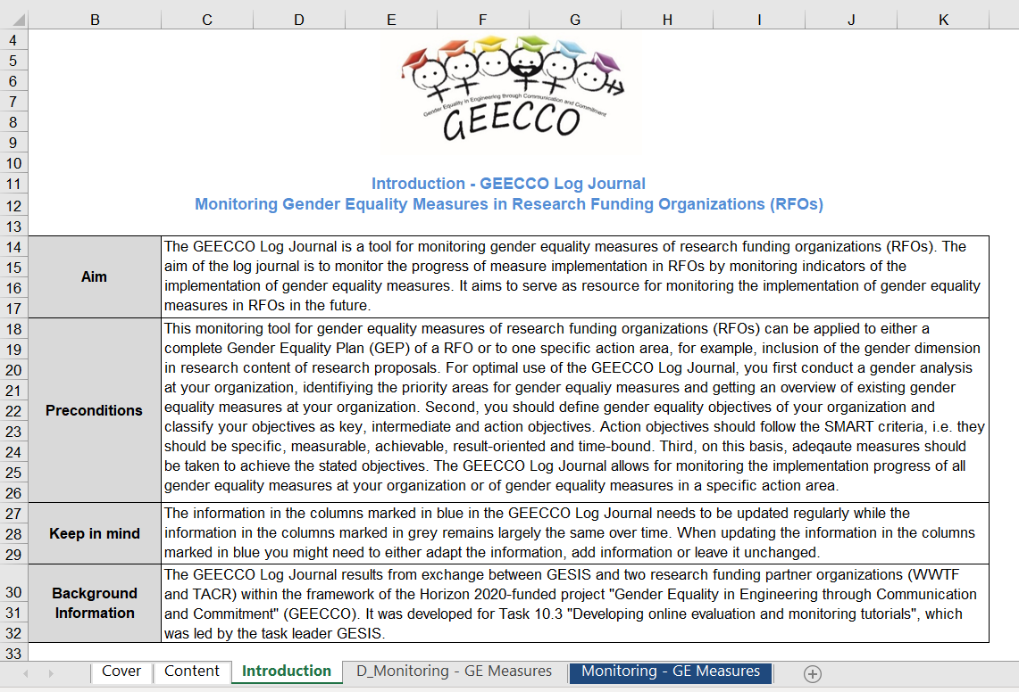
Step-by-Step Guide – Step I
Read the introduction sheet of the GEECCO Log Journal.

Slide 8
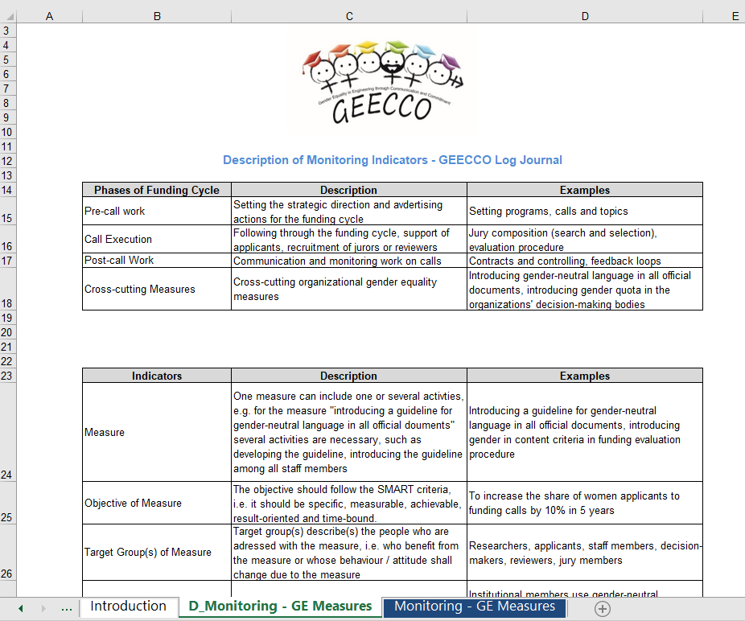
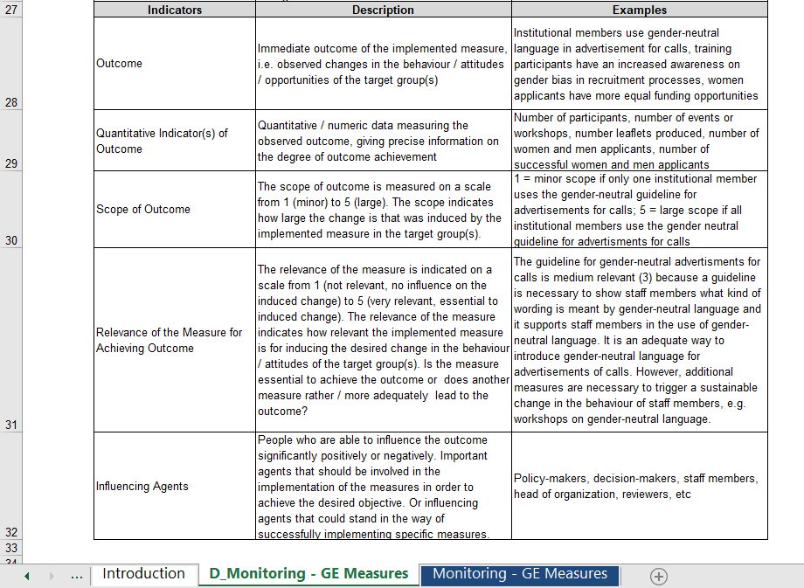
Step-by-Step Guide - Step II
Read the description sheet ‘D_Monitoring GE Measures‘ of the GEECCO Log Journal, including detailed information and examples of indicators.

Slide 9
Indicators for monitoring the implementation of gender equality measures
Measure: can include one or several activities for achieving the stated objective
Objective of measure: should be specific, measurable, achievable, result-oriented and timebound
Target group(s) of measure: describe(s) the people who are adressed with the measure
Outcome: observed changes in the behaviour, attitudes or opportunities of the target group(s)
Quantitative indicator(s) of outcome: numeric data measuring the observed outcome
Scope of outcome: how large is the observed change in your organization
Relevance of the measure: how relevant is the specific measure for reaching the stated goal
Influencing agents: people who can influence the outcome positively or negatively

Slide 10
Step-by-Step Guide - Step III
Before entering data on the implementation progress of the gender equality measures, also make sure that the described phases of the funding cycle are align with your organization’s funding processes and structure. If not, you can adapt the phases in a way that resembles the different action areas of your gender equality measures.

Slide 11
Step-by-Step Guide - Step IV
Then start entering the required data for each gender equality measure by your action areas / funding cycle phases.
Above each column of the monitoring sheet ‘Monitoring – GE Measures’, you find detailed information on each indicator.
The first two rows of the GEECCO Log Journal are filled with examples. These shall provide you with a better understanding of what content could be put in each of the columns. When using the GEECCO Log Journal for your own gender equality measures, delete the pre-filled examples.

Slide 12
Examples - Information on each indicator of the GEECCO Log Journal

Slide 13
Examples – How to fill each column of the GEECCO Log Journal

Slide 14
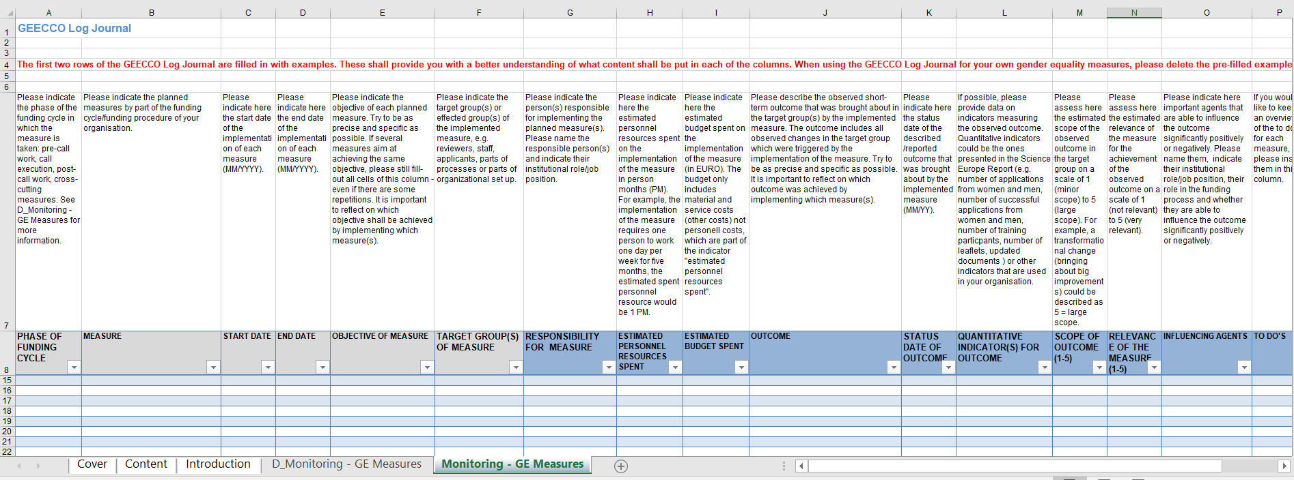
Step-by-Step Guide - Step V
The information in the columns marked in blue in the GEECCO Log Journal needs to be updated regularly while the information in the columns marked in grey remains largely the same over time. When updating the information in the columns marked in blue you might need to either adapt the information, add information or leave it unchanged.

Slide 15
Background Information – Tutorial Development
The GEECCO Log Journal results from exchange between GESIS and two research funding partner organizations (WWTF and TACR) within the framework of the Horizon 2020-funded project "Gender Equality in Engineering through Communication and Commitment" (GEECCO).
GEECCO aims to establish tailor-made Gender Equality Plans (GEPs) in four European universities (RPOs) and to implement the gender dimension in two research funding organisations (RFOs) in funding schemes, programmes and review processes.
The GEECCO Log Journal tutorial (see below) is specifically addressed to the needs and change processes relating to monitoring of research funding organisations.

Slide 16
Created by
Claudia Schredl
GESIS - Leibniz Institute for the Social Sciences
Center of Excellence Women and Science (CEWS)
Unter Sachsenhausen 6-8
50667 Cologne, Germany
claudia•schredl[at]gesis•org
Within the Framework of the Horizon 2020-funded Project
Gender Equality in Engineering through Communication and Commitment (GEECCO)
Grant Agreement Number 741128
funded by
the European Commission

