Slide 1
Introduction to EU-SILC
DwB Training Courses on EU-SILC Longitudinal
Paris, February 2014

Slide 2
AGENDA
Scope of the instrument
Organization of the data
Main statistical concepts
Information sources

Slide 3
1. Scope of the SILC Instrument - OVERVIEW
Annual data: cross-sectional and longitudinal (4-years-traces)
Information on both households and individuals (micro level)
Income and tax
Material deprivation
Housing conditions
Employment, Childcare
Health, Education
Output harmonization
Definition of target concepts/variables to be measured
Standardized output (format and content)
Common guidelines monitored by Eurostat

Slide 4
1. Scope of the SILC Instrument - CONTENT
Participating countries (by first year of implementation)
2003: BE, DK, EL, IE, LU, AT, NO 2004: EU-12 + IS, EE 2006: EU-25 + TR, BG 2007: EU-27
2010: HR
Reference population:
All private households and their current members Excluded: people in collective households and institutions
Sample size
Minimum precision criteria for key indicator, to produce results both at country and EU level (precision of at-risk-of-poverty rate of 1%)

Slide 5
1. Scope of the SILC Instrument - SPECIFIC TOPICS
Topics covered in the annual modules
2005: Intergenerational transmission of poverty;
2006: Social participation;
2007: Housing conditions;
2008: Over-indebtedness and financial exclusion;
2009: Material deprivation;
2010: Intra-household sharing of resources;
2011: Intergenerational transmission of disadvantages (~2005);
2012: Housing conditions (~2007);
2013: Well-being;
2014: Material Deprivation
Variables included in the cross-sectional data / not in longitudinal
EC-Regulation for each module

Slide 6
2. Organization of the data – BACKGROUND
Regulations (European Law):
Clear specifications of deliverables
Obligation of Member States to deliver data
Methodology to be followed " Guidelines Doc65_2011.pdf "
Implementation:
Surveys designed & carried out nationally
Microdata validated first nationally then by Eurostat
Indicators (aggregated data) computed and disseminated
National and EU quality reports

Slide 7
2. Organization of the data – OVERVIEW
National flexibility in the implementation:
Source: survey and/or registers (DK, NL, SI, FI, SE, IS, NO)
Fieldwork: one-shot (≠ length) or continuous survey
Income reference period: fixed or moving 12-months
Imputation method for income variables
Survey design
Logic of the data files:
Linkable 4 files per country and year:
D-file => Region, Deg_Urba, HH-weight, …
H-file => Income, Material Deprivation, …
R-file => Age, Gender, Personal weights, …
P-file => Health, Labour, Education, …
Longitudinal and cross-sectional files cannot be linked !!!

Slide 8
2. Organization of the data – PROCESSING
Fieldwork in countries in year N
Data transmission to Eurostat by November N + 1
Final checking (1-2 weeks)
Upload of indicators (every mid-month)
Compilation of explanations & quality reports
Data release to researchers (UDB) in March N + 2
Including revisions from the previous operations
Longitudinal files: same process, around 6 months later

Slide 9
2. Organization of the data – ANONYMISATION
Some common rules for the UDB data:
Region: changed from NUTS2 to NUTS1
Points of time: months recoded into quarter
Number of rooms: top-coded to 6+
Age: top-coded to 80+
PSU: randomised
Additional country-specific provisions

Slide 10
3. Main statistical concepts – BACKGROUND
Typology of variables – Discrete (nominal, ordinal, binary) & Continuous (i.e. income)
Statistical units
households with specific characteristics
persons with specific characteristics
persons living in households with specific characteristics
Usage of weights for longitudinal analysis
RB062 for transitions between year N-1 (2010) and year N (2011)
RB063 for transitions within years N-2 and N
RB064 for 4 years transitions

Slide 11
3. Main statistical concepts – INCOME DISTRIBUTION
Background information:
All Income data in the UDB is in Euro
Exchange rates provided in the data, relevant PPS on CIRCABC
Living standards – affected by income, size and composition of the households
Equivalisation of household income = HY020
Equivalisation scale – a convention on needs
Results in equivalised disposable income on personal level = HX090
All persons of a household 'receive' the same amount, don't sum it!!!
Example: Share and cut-off points of percentiles

Slide 12
3. Main statistical concepts – LABOUR TRANSITIONS
BasIs
Employment status as the self-defined current economic status (variable PL031)
Technics
All persons aged between 16 and 64 years
RB062 is used for weighting
Interpretation
Share of working-age persons who move between employment status (or retain the same status) between two consecutive years

Slide 13
3. Main statistical concepts – EMPLOYED PERSONS, 2010-2011

Slide 14
3. Main statistical concepts – UNEMPLOYED PERSONS, 10 - 11

Slide 15
3. Main statistical concepts – PERSISTENT POVERTY
Basis – monetary concept of relative poverty
Equivalised disposable income (longitudinal)
Threshold = 60% of the national median income (cross-sectional)
Technics
All persons being in the panel for 4 years
RB064 is used for weighting
Interpretation
Share of people who were poor in the last year and at least 2 out of the preceding 3 years

Slide 16
3. Main statistical concepts – PERSISTENT POVERTY

Slide 17
4. Information Sources – OVERVIEW
Documentation on the CD-ROM
SILC homepage
Eurostat → Statistics → Income and Living Condition
Data, Methodology, Legislation, Quality, Publications
CIRCABC, EU-SILC user group, Library
4.1. User Database – more information
3.2. Indicators – all programs of Eurostat for indicators

Slide 18
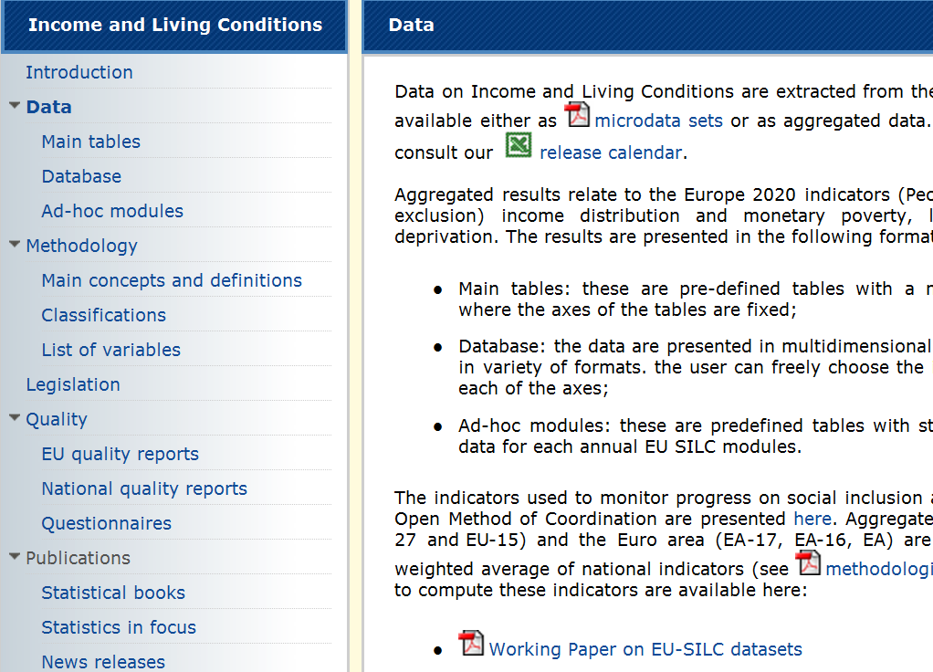
4. Information Sources – SILC homepage

Slide 19
Thank you for your attention
Questions and comments
Ideas for improvement
Additional remarks in writing: Boyan.Genev@ec.europa.eu

