Slide 1
Introduction to Training Data

Slide 2
SILC data as delivered from Eurostat
Features of training dataset

Slide 3
Some essentials - Specifics of file names
UDB_l11D_ver 2011-1 from 01-08-2013.csv
UDB_l11H_ver 2011-1 from 01-08-2013.csv
UDB_l11R_ver 2011-1 from 01-08-2013.csv
UDB_l11P_ver 2011-1 from 01-08-2013.csv
UDB_c11D_ver 2011-2 from 01-08-13.csv
UDB_c11H_ver 2011-2 from 01-08-13.csv
UDB_c11R_ver 2011-2 from 01-08-13.csv
UDB_c11P_ver 2011-2 from 01-08-13.csv

Slide 4
Some essentials - Specifics of file names
UDB_l11D_ver 2011-1 from 01-08-2013.csv
UDB_l11H_ver 2011-1 from 01-08-2013.csv
UDB_l11R_ver 2011-1 from 01-08-2013.csv
UDB_l11P_ver 2011-1 from 01-08-2013.csv
UDB_c11D_ver 2011-2 from 01-08-13.csv
UDB_c11H_ver 2011-2 from 01-08-13.csv
UDB_c11R_ver 2011-2 from 01-08-13.csv
UDB_c11P_ver 2011-2 from 01-08-13.csv

Slide 5
Some essentials - Specifics of file names
UDB_l11D_ver 2011-1 from 01-08-2013.csv
UDB_c11D_ver 2011-2 from 01-08-13.csv
UDB = Userdatabase (anonymised data)
_l = longitudinal file/_c = cross file
11 = year of the survey (c-file)/year of last wave (l-file)
D=Household Register/H=Household Data/R=Personal Register/P=Personal Data
2011-1 = # of version (e.g. 1st version of the 2011 data)
csv = type of data (e.g. comma separated values)

Slide 6
Transform *.csv to *.sav and *.dta
GESIS offers tools to transform Eurostat SILC files to SPSS and Stata format
Go to http://www.gesis.org/en/services/data-analysis/official-microdata/european-microdata/eu-silc/eu-silc-tools/
Download SPSS or Stata routines, adapt them to your local computing environment and run them

Slide 7
SILC longitudinal training data
Drop household with more than 5 members
Random selection of 30% of the remaining cases but not more than 1500 cases per country
Drop regional information (DB040) and primary sampling (DB060)
12 countries granted access
Data are not suitable for research!

Slide 8
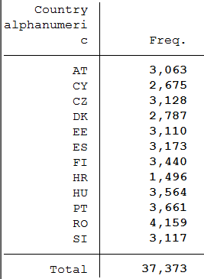
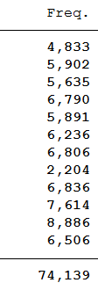
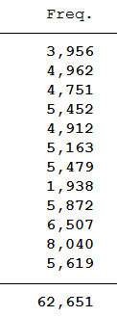
SILC longitudinal training data, observation years
HH-reg. HH-data Pers-reg. Pers.-data
D H R P

