Slide 1
Introduction to the GESIS Data Services
Meet the Experts – GESIS online talks
Data Services, Data Archiving, and Research Data Management
Oliver Watteler, 28.09.2023

Slide 2
Logistics: Information prior to the talk
This talk will be recorded. We do not record the Q&A session after the talk.
Participants are muted during the session. Questions will be collected during presentation and answered after the talk.
Please ask questions to “moderator" via the chat function
If you post in the general chat, your name and message will be visible to all participants. Of course, this is also possible. It would be better, however, if you send your questions to "meetexperts."
Recording and slides will be made publicly available on the GESIS website and on our YouTube channel.

Slide 3
Speaker
Oliver Watteler (M.A.)
Head of team Data Acquisition and Access (DAA)
Since 2006, responsible for data acquisition and general user consulting Focus: Legal Issues and Data Protection
In charge of GESIS Data Services
Research interests: Research Data Management, Data Protection
Contact: oliver.watteler@gesis.org

Slide 4
Introduction to the GESIS Data Services
Meet the Experts – GESIS online talks
Data Services, Data Archiving, and Research Data Management
Oliver Watteler, 28.09.2023

Slide 6
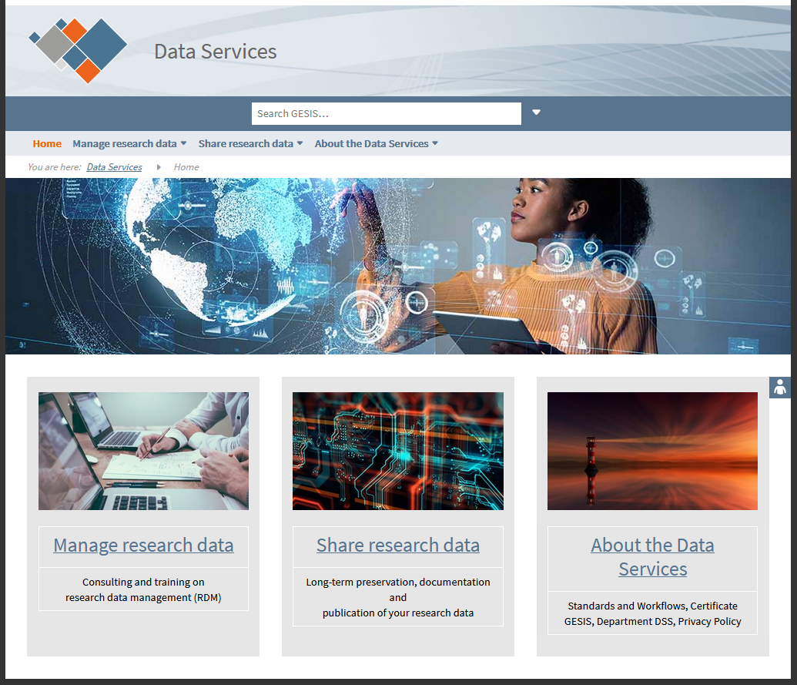
GESIS Data Services - Overview

Slide 7
Main aims of GESIS Data Services
Focus: quantitative social science data
Support researchers to meet challenges of research data management (RDM) and requirements of funders:
Offer advice and training on RDM topics
Provide information on RDM online
[Presented in separate session]
Offer services that help researchers to make their data Findable, Accessible, Inter-Operable, Re-Usable (FAIR):
Choice of three services packages Archiving BASIC / PLUS / PREMIUM
How-to Guide with initial instructions

Slide 8
Data publication how-to: initial questions
§
Do you hold the appropriate rights to publish your data?
Are there any legal of ethical restrictions?
Is the data in an file format that is suitable for long-term preservation?
Is the data sufficiently documented?
Can others understand how the data came about?
Is the data itself „clean“ and understandable?

Slide 9
Three Service Packages
Archiving BASIC
„Self service“ data publication - free of charge
Archiving PLUS
Standard data publication - fixed price
Archiving PREMIUM
Archiving PLUS with extensive quality assurance and documentation on variable level – price on demand
Packages are built on each other
[On-site access via Secure Data Center as special for cost service – part of separate presentation]

Slide 10
Archiving BASIC
Storage of your files for at least 25 years (bitstream preservation)
Bitstream preservation = preservation of file as is
Long-term preservation also about readability and usability
Ingest check BASIC
Basic checks without quality assurance
DOI registration
Form to describe your data with supplementary information (metadata)
Publication of your data via our repository

Slide 11
Archiving PLUS
Ingest check PLUS
Matching questionnaire/code schema with variables in the data set
Check of variable and value labels
Check of missing values
Long-term digital preservation
If applicable, technical format migration
High quality, qualified study(*) description
German and English
DOI registration
Publication of data and documents for download
(*) ‘Study’ = a unit comprising one or more related data files and documents

Slide 12
Archiving PREMIUM
Basis is Archiving PLUS
Ingest check PREMIUM
More checks on quality issues
Quality assurance
Testing of the routing (ex post)
Check for substantive consistency
Checking your data in case of multiple responses
Documentation also on variable level

Slide 13
Three Service Packages - Overview
 | Archiving BASIC | Archiving PLUS | Archiving PREMIUM
Ingest check | BASIS | -- | --
 |  | PLUS | --
 |  |  | PREMIUM
Study description | Self description | -- | --
 |  | Description by GESIS | Description by GESIS
Preservation | Bitstream Preservation | -- | --
 | Conversion of files into preferred formats | Long-term preservation | Long-term preservation
 |  |  | Quality assurance
 |  |  | Documentation on variable level
Access | Download | Download | Download
Persistent Indentifier | DOI | DOI | DOI

Slide 14
Recommendations
Check out our website!
Take a course and learn about general RDM!
Contact us early in your project!
Work with us on your data publication before your project ends!
https://www.gesis.org/en/data-services

Slide 15
Expert contact & GESIS consulting
Contact: you can reach the speaker via e-mail: oliver.watteler@gesis.org
GESIS Consulting: GESIS offers individual consulting in a number of areas – including survey design & methodology, data archiving, digital behavioral data & computational social science – and across the research data cycle.
Please visit our website www.gesis.org for more detailed information on available services and terms.

Slide 16
Upcoming talks
Please visit our meet-the-experts website:
https://www.gesis.org/en/services/sharing-knowledge/consulting-and-guidelines/meet-the-experts

Slide 17
Thank you for participating!

