Slide 1
Part II Practical Training Session: Cross-sectional data structure & analyses – Introduction
EU-SILC Training Course
12.04.2024
Klaus Pforr
Contact: eu-microdata@gesis.org

Slide 2
Overview
Short introduction of cross-sectional data specifics
Data structure exercises

Slide 3
Short introduction of cross-sectional data specifics
Delivered data files
Levels of observation
Longitudinal time-series
Flag variables
Selected respondent
Weights

Slide 4
Short introduction of cross-sectional data specifics
Delivered data files
  How the data are collected
  How they are delivered
D-File
All selected households
H-File
All contacted households
R-File
All current household members
P-File
All current household members aged 16+, info collected from survey or register
1:1
1:m
1:1
D-File
All contacted households
H-File
All contacted households
R-File
All current household members
P-File
All current household members aged 16+, info collected from survey or register
1:1
1:m
1:1

Slide 5
Short introduction of cross-sectional data specifics
Levels of observation
Year DB010, HB010, RB010, PB010 | Country DB010, HB010, RB010, PB010 | Household ID DB030, HB030, RX030, PX030 | Person ID RB030, PB030 | Partner ID RB240 | Father ID RB220 | Mother ID RB230
2021 | AT | 1 | 1 | 2 | 4 | 5
2021 | AT | 1 | 2 | 1
2021 | AT | 1 | 3 |  | 1 | 2
2021 | AT | 1 | 4 | 5
2021 | AT | 1 | 5 | 4

Slide 6
Short introduction of cross-sectional data specifics
Levels of observation
Year | Country | Household ID | Person ID | Partner ID | Father ID | Mother ID | Person-level variable
2021 | AT | 1 | 1 | 2 | 4 | 5 | Male
2021 | AT | 1 | 2 | 1 |  |  | Female
2021 | AT | 1 | 3 |  | 1 | 2 | Male
2021 | AT | 1 | 4 | 5 |  |  | Female
2021 | AT | 1 | 5 | 4 |  |  | Male
Switching from persons to households
Year | Country | Household ID | Household-level variable
2021 | AT | 1 | 5 persons in household

Slide 7
Short introduction of cross-sectional data specifics
Levels of observation
Year | Country | Household ID | Person ID | Partner ID | Father ID | Mother ID | Person-level variable
2021 | AT | 1 | 1 | 2 | 4 | 5 | Male
2021 | AT | 1 | 2 | 1 |  |  | Female
2021 | AT | 1 | 3 |  | 1 | 2 | Male
2021 | AT | 1 | 4 | 5 |  |  | Female
2021 | AT | 1 | 5 | 4 |  |  | Male
Switching from persons to couples
Year | Country | Household ID | Person ID | Partner ID | Couple-level variable
2021 | AT | 1 | 1 | 2 | Age difference 5 years
2021 | AT | 1 | 4 | 5 | Age difference 3 years

Slide 8
Short introduction of cross-sectional data specifics
Levels of observation
Year | Country | Household ID | Person ID | Partner ID | Father ID | Mother ID | Person-level variable
2021 | AT | 1 | 1 | 2 | 4 | 5 | Male
2021 | AT | 1 | 2 | 1 |  |  | Female
2021 | AT | 1 | 3 |  | 1 | 2 | Male
2021 | AT | 1 | 4 | 5 |  |  | Female
2021 | AT | 1 | 5 | 4 |  |  | Male
Switching from persons to parent-child dyads
Year | Country | Household ID | Person ID | Mother ID | Parent-child-dyad-level variable
2021 | AT | 1 | 1 | 5 | Mother‘s age at birth 35
2021 | AT | 1 | 3 | 2 | Mother‘s age at birth 25

Slide 9
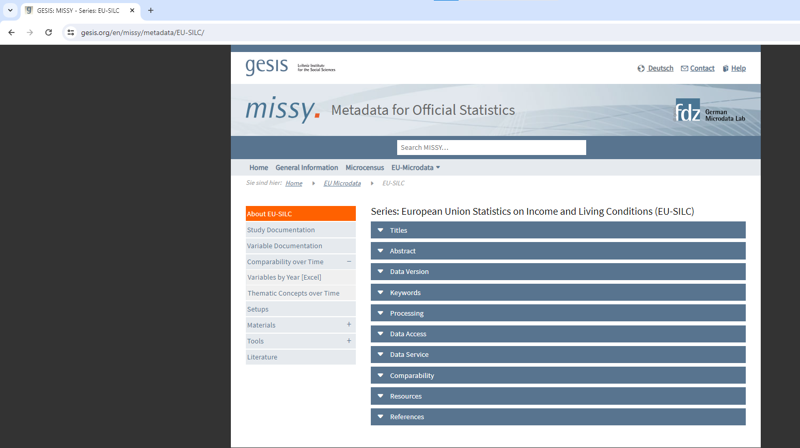
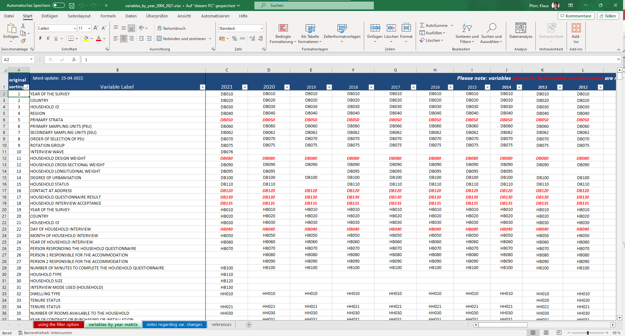
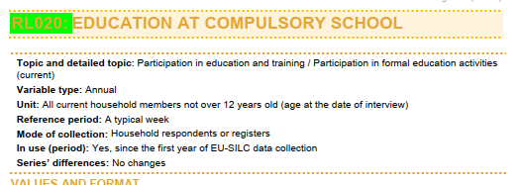
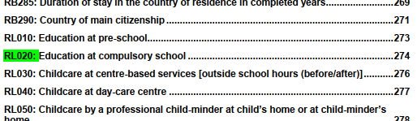
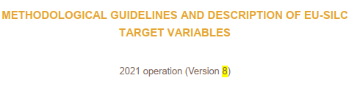

Short introduction of cross-sectional data specifics
Longitudinal time-series
Ex-ante output harmonization across countries
There are changes across time
How to identify changes across time
  MISSY → Variables-by-year matrix
  https://www.gesis.org/fileadmin/upload/dienstleistung/daten/amtl_mikrodaten/europ_microdata/EU-SILC/Tools/variables_by_year_2004_2021.xlsx
  Colored highlighting in user guide

Slide 10
Short introduction of cross-sectional data specifics
Flag variables
  Indicate
    Missings due to filtering
    Missings due to population defintion, e.g. non-selected respondents
    Item nonresponse
    For income variables, data collection and imputation details

Slide 11
Short introduction of cross-sectional data specifics
Selected respondents
  Some countries choose the selected respondent model
    in 2021 DK, FI, NL, SE, SI
  For these, subset of variables in P-file is collected only for one person in the household aged 16+
  For the other countries, these variables are collected for all persons in the household aged 16+

Slide 12
Short introduction of cross-sectional data specifics
Weights
  in the cross-sectional files
Variable | Variable label | When to use
DB090 | Household cross-sectional weight | Unit of analysis households
RB050 | Personal cross-sectional weight | Unit of analysis all persons in the household
PB040 | Personal cross-sectional weight | Unit of analysis all persons in the household aged 16+, in non-selected-respondent countries
PB060 | Personal cross-sectional weight for selected respondent | Unit of analysis all persons in the household aged 16+, in selected-respondent countries
RL070 | Children cross-sectional weight for child care | Unit of analysis all household members aged 0-12

Slide 13
Short introduction of cross-sectional data specifics
Questions?
Otherwise, let‘s go to the actual exercises!

Slide 14

Thank you

